Slide 1
PGC-D3 Small Scale LNG Region: America

Slide 2
Scope
Provide overview of data collected in the sub group Americas
Present information in alignment with report structure
Outline
Subgroup composition
Drivers and Business Models (e.g. per “sub-areas”)
Players
Safety, Standards and Regulations

Slide 3
Sub-Regions
REGION:
America
SUB-REGIONS:
North America
Caribbean&Central America
Southern Cone.

Slide 4
North America Characterization
General overview on current’s LNG industry in the area:
Shale gas has spurred the swift metamorphosis of the United States from global buyer to seller of LNG while Canada has to find a new destination for its gas.
The vibrancy of U.S. exports depends on Department of Energy approvals for sending LNG to countries that are not free-trade partners with the United States. Twenty LNG export applications are awaiting decisions by the Department of Energy.
The combined impact of potential rising feed gas prices and higher LNG development costs could likely restrict the volumes of U.S. LNG export capacity developed.
The Western Canadian projects all focus on large but remote shale gas reserves in the provinces of British Columbia and Alberta. The Canadian projects would need to build their own LNG storage tanks, docks, jetties and pipeline connections (two mountain ranges).

Slide 5
North America Characterization
Small Scale LNG Overview:
The Small Scale has been traditionally considered a Niche business in North America.
The main Small Scale LNG activity in NA has been concentrated in Peak-Shaving, although LNG volumes stored (around 90bcf) compared with Gas storage in depleted gas fields, salt caverns or aquifers (almost 4 Tcf) represents a small proportion, around 2.2%.
The main drivers for the growth of the Small Scale demand for LNG stems from two main forces:
Economical: The existing gap between oil and natural gas prices along with the high availability of gas in the area allows the increase of this type of facilities.
Environmental: Natural gas burns more cleanly than other fossil fuels, and government are demanding fewer toxic and greenhouse-gas emissions from power plants, ships, trucks and other fuel users.

Slide 6
North America Characterization
Small Scale LNG Main Activities:
PEAK-SHAVING
In the United States, one plant made LNG for export — in Nikiski, Alaska — and 59 made LNG for peak shaving, according to Energy Information Administration. In addition, the United States had 41 other sites where LNG was trucked in and stored for peak shaving but where no LNG making occurred.
The U.S. Energy Information Administration calls gas storage and peak shaving "a risk-management calculation" by the utility or pipeline company. It's costly to install storage and peak-shaving plants. "However, the cost of a service interruption, as well as the cost to an industrial customer in lost production, may be much higher" if they don't have gas when they need it. In the gas-storage game, LNG plays a bit part
A typical U.S. LNG for peak-shaving plant can process 5 million to 20 million cubic feet of gas per day, according to Black & Veatch.
In annexes it is shown a relation of Peak shaving facilities in NA, (It may not be including some recent plant commissioning).

Slide 7
North America Characterization
ISOLATE/REMOTE TRUCKING LNG
LNG is either made at peak-shaving sites or trucked there in special insulated tanks — commonly 40-foot-long thermos bottles on wheels, some examples in the US are:
A U.S. company called Applied LNG Technologies has been trucking LNG to Mexico since at least 1998 from a liquefaction plant in Topock, Ariz on a very small scale.
Since 1998, Fairbanks Natural Gas LLC has trucked LNG from its small liquefaction plant served by Alaska's Cook Inlet gas fields to customers 300 miles north in Fairbanks.
Hawaiian utilities also are moving to import LNG instead of burning more costly and dirtier oil-derived fuels. Because Hawaii's demand would be so small, the gas utility looks to start with a pilot project of LNG delivered in insulated containers loaded aboard cargo ships that call on the state

Slide 8
North America Characterization
LNG AS A FUEL: HEAVY-DUTY TRUCKS
LNG is also a niche fuel for vehicles, and has been historically the Chicken and the egg dilemma, but the gap in prices between Oil & Gas is encouraging organizations, as Clean Energy Fuels to develop a chain of LNG fueling stations across the country.
Many of the 3.5 thousand vehicles that use LNG in U.S. are trucks that move cargo around the huge neighboring ports of Los Angeles and Long Beach, California. To cut air pollution, those ports prohibit drayage trucks from burning dirty fuels. Some city and regional buses, garbage trucks, heavy-duty tractors also use LNG.
Natural Gas Vehicle for America, has laid out its own roadmap for wider use of LNG-powered trucks. A similar effort is under way in Canada, called the Canadian Blue Corridor, which would space LNG fueling stations every few hundred miles along major trucking corridors.
Those sites are mainly supply by Trucking LNG, giving an alternative usage for a Small Scale LNG plant other than Peak Shaving. This is giving the chance to build new plants all over the country, as is the case of Shell Small Scale plants in the two new LNG transport corridors in the Great Lakes and Gulf Coast regions, that follows the one already in construction in Alberta.

Slide 9
North America Characterization
LNG AS A FUEL: BUNKERING
The chicken-and-egg riddle restrains widespread use of LNG fuel for ships as well. The world has only a few places where ships can top off their LNG tanks.
Lloyd's is one of the big international organizations that establish technical standards for ship construction and operations. In its report, Lloyd's predicted just 4 percent of new ships delivered by 2025 — 653 ships total — would use LNG fuel. These ships most likely will be container ships, cruise ships or oil tankers, Lloyd´s predict LNG fuel will start picking up market share around 2019, before even-stricter IMO standards kick in.
It is likely that environmental reasons are not sufficient to develop beyond industry and the price gap between gas and oil must remain wide in order to develop the industry and also new liquefaction plants and storage would be needed to supply ports where no LNG exists today.
Some projects had been announced within NA to provide LNG fuel, in addition to the previously mentioned by Shell:
New Orleans-based Harvey Gulf International has secured plans to construct and operate an LNG marine fueling facility out of Port Fourchon, LA. The facility will consist of two sites each having 270,000 gallons of LNG storage capacity and the ability to transfer 500 gallons of LNG per minute.

Slide 10
North America Characterization
IMPORT/EXPORT PROJECTS
A wide number of projects have been announced and are waiting to receive approval from DOE, some of them are permits for Small Scale projects.
Carib Energy (Crowley): The company plans to transport LNG from liquefaction facilities all along the Gulf coast using approved 40-foot LNG ISO containers transported on ocean-going carriers.
Waller Point LNG: Using small-scale liquefaction technology, Waller Marine plans to install nominal 500,000 gallon per day LNG trains in phases as the market (Caribbean) and demand for marine LNG fuels expands. The Waller Marine’s focus is to supply LNG to the marine fuels market. The WMI Articulated Tug and Barge system (ATB-LNG) is a solution for the transportation, storage and regasification of relatively small quantities of LNG over short distant routes.
BC LNG (Douglas Channel LNG): The project consist in:
A barge-based liquefaction plant to convert natural gas to LNG.
A small LNG buffer tank, electrical substation, and other support facilities on land adjacent to the LNG barge.
A new LNG jetty and berth with loading facilities. Infrastructure to connect existing gas pipeline, electrical power, and roads to the project site.

Slide 11
Conclusion, General Observations for North America
The development of shale gas in North America has led the market reverse from net importer of Gas to a potential exporter, as well as the development of different activities related to the Gas. This expansion in the use of gas, supported by surplus gas and low prices of HH, are developing numerous projects related to LNG, most of them small and medium scale, with the exception of large export projects.
It can be expected a blooming of the Small Scale LNG business in the US, form the Niche position that it has in the pass, to growth in wide number of applications, reliability and probably technological and in cost efficiency.
The drivers for this blooming are mainly economical, but some of them are also sponsored by environmental aspects, as is the case of Bunkering, some Gas stations, and peak liquefaction plants, that gives flexibility and reliance to a cleanly of the natural gas burns in comparison to other fossil fuels.
A numerous new players are getting involved in this emergency market within North America, some of them without previous experience in such sector but with the technical support of companies well-established and with knowledge and experience in the LNG industry.

Slide 12
Caribbean and Central America Characterization
General overview on current’s LNG industry in the area:
The only LNG producing (liquefaction) facilities are located in T&T (up and running since 1999) with an overall capacity of 22,4 Mtpa (composed by 4 baseload liquefaction trains). This facility supplies LNG mainly to European and North America markets, but also to the existing regas facilities in the area.
Since many years ago, Venezuela has been considering LNG exports with different projects that, so far, didn’t go ahead, despite the huge gas reserves of the country.
Dominican Republic and Puerto Rico are the only countries in the area with installed regas capacity: 1,9 Mtpa in Andrés (Dominican Republic) and 1,8 Mtpa in Peñuelas (Puerto Rico); both terminals receive LNG supply mainly from T&T and don’t have a real open access regime. The main driver for this gas consumption is power generation.

Slide 13
Caribbean and Central America Characterization
Small LNG overview:
There are, currently under different stages of development, some new potential small scale projects in the area. Mainly balanced to consumption (regas):
Small LNG Consumption panorama:
The Caribbean&Central America potential consumption markets have a strong potential for small scale LNG developments. Main Drivers:
Apetite for gas as alternative fuel with respect oil related products (price, efficiency, environment)
The distance of most of the potential consumptions (many islands) in the area with respect the potential gas supplies make the LNG as the main logistics alternative
For having access to international LNG supplies (out of the area), these markets would have to compete, in terms of price, with other international big LNG consumers.
Small and discretized (non-connected) consumptions, only some countries can achieve an aggregated potential consumption for base load regas terminals. This makes that small scale projects, if technical and economically feasible, fit with the size of most of the potential consumptions.
In some cases the related consumptions have a strong seasonal component.

Slide 14
Caribbean and Central America Characterization
Power generation is one of main drivers for gas consumption (fuel switching). Some countries don’t have an easy power interconnection so specific regas facilities are required for specific power developments (limited demand aggregation potential)
Other main potential consumers are raw industries (e.g. mining) frequently located far from transport lines (both gas or power generation) and therefore requiring an specific import facility for fitting their consumption with limited aggregation capacity.
Many projects announced, many potential consumers willing to develop small LNG developments but challenges for progressing with those projects: unit costs, securing financing and securing LNG supply (that require long term commitments and therefore balance sheet capabilities).
Key players:
For securing consumption: Utilities (power generators), Mining companies (extraction&treatment) and many times National Companies (power generation or distribution) that try to aggregate different consumptions.
For implementing the required regas infrastructures:
The regas technologies usually involved in this kind of projects make use of e relatively tested (peak shaving, satellite LNG plants) existing ones with their main providers.

Slide 15
Caribbean and Central America Characterization
many times the promoters issue tenders for construction&operation companies bringing both the technical expertise and financing capacities (BOO). In some cases the requirement is done altogether with the construction of the envisaged consumption facility (power generation). Both onshore and offshore.
Fast track solutions are usually required, potential for smals scale FSRUs.
For LNG supply:
Most of the current LNG supplies from the area (T&T) are already committed to long term contracts.
Many consumption projects look at the US developments as their “natural” LNG supplier. Notwithstanding, these US developments have the opportunity to achieve the international premium markets with conventional carriers.
Some projects make international supply tenders and receive offers from international LNG operators that have capabilities for supplying the alternative premium markets.
Attracting LNG volumes from international LNG markets require “conventional” LNG carriers sizes; therefore the risk of sub optimization of receiving terminals is not negligible.
Currently, only a potential “small scale” supplier with FID in the area (Pacific Rubiales)

Slide 16
Caribbean and Central America Characterization
Small LNG production&transport panorama:
Main Drivers:
Monetization of small-medium scale gas resources:
Without a clear access to domestic consumptions.
Without “critical mass” as to be processed or aggregated conventional “base load” LNG developments.
Requirement for innovative configurations as to overcome des-economy of scale. At the same time, try to maximize the use of proven small scale liquefaction modules (expertise from peak shaving facilities) for reliability.
The only small scale liquefaction project currently sanctioned (0,5 Mtpa Pacific Rubiales in Colombia) is an offshore development, probably because of cost efficiency with respect onshore.
Markets flexibility: although there are other logistics alternatives for small scale gas production, such as CNG, the LNG provides access to many markets with ability for diversions.
Ability for making use of both conventional size carriers (international markets) and smaller scale ones (regional markets)

Slide 17
Caribbean and Central America Characterization
Key players:
Upstream (feedgas):
Independent E&P companies with, “stranded” gas resources in terms of conventional size LNG developments, and with appetite for new concepts (such as Pacific Rubiales in Colombia) or with some aggregation capabilities from small producers.
Companies with some abilities and interests for aggregating spare production and for developing regional LNG markets with customized solutions.
Liquefaction (facilities):
Technology providers with experience in small scale liquefaction developments and providing “proven” solutions in other market niches (peak shaving, floating LNG solutions).
“Integrators”: companies that put together liquefaction technology providers, shipyards and integrally develop the project under a BOO (build own and operate) business model.
Shipping:
Companies with experience and/or innovative solutions for small – mid scale shipping (<40.000 m³ LNG) and with conventional size carriers.

Slide 18
. Safety, Standards and Regulations
In general terms, most of the countries with potential projects don’t have a specific regulation for LNG receiving terminals. In order to attract investors for developing receiving terminals the regulatory framework needs to be defined. Notwithstanding, many of the projects under study count with those countries authorities’ support.
In Dominican Republic and Puerto Rico with already existing LNG receiving terminals the main regulatory issue is that there are not open access, this makes that other potential LNG consumers don’t have the possibility to access LNG except by developing their own receiving facility.
The only small scale project already sanctioned in the area, Pacific Rubiales in Colombia (exporting, but also potentially importing facility), is subject to the gas regulatory framework led by the Ministry and CREG (domestic energy agency). The gas regulatory framework in Colombia sets, as mandatory, that the national gas supply/demand projections are positive for at least the following 8 years in order to allow gas exports.
…

Slide 19
Conclusion, General Observations for Caribbean and Central America
The Caribbean/Central America area is a clear niche for small scale LNG developments, mainly for regas/consumption purposes, due to two main characteristics:
Abundance of small size (and isolated) markets
Potential premium prices as LNG would substitute other oil related fuels.
The main challenges for the development of the small scale projects are:
Des-economy of scale. The technology/configuration improvements related to reduce unit cost are key.
Financing/long term commitments for small size companies.
Securing LNG supplies being competitive with other premium markets.

Slide 20
South Cone Characterization
Missing

Slide 21
Projects Overview
Project | Typology/Description (e.g. consumption or production driven) | Players | Drivers and Business Model
Pacific Rubiales (Colombia) | Primarily, export driven but with capacity to reverse and import | Pacific Rubiales (O&GC) Exmar (time charterer) on BOO basis Wison (shipyard) Black&Veatch (topsides) | Monetization of “La creciente” small scale reserves. Capacity to shift from export to import depending on Colombian market requirements. Ability for small scale logistics (ships): potential for Caribbean niche markets LNG SPA with Gazprom for first 5 years of operation.

Slide 22
Annex: North America’s small scale shortlist

Slide 23
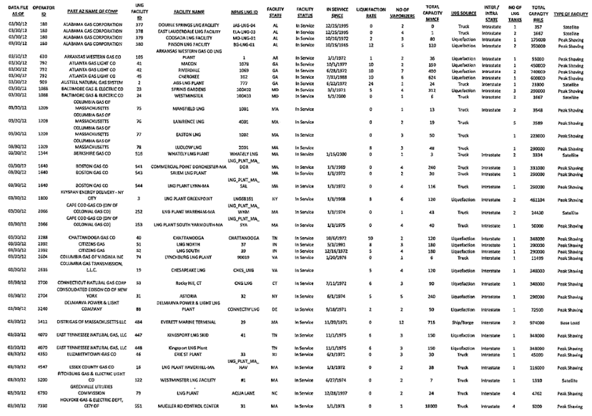
North America’s small scale facilities

Slide 24
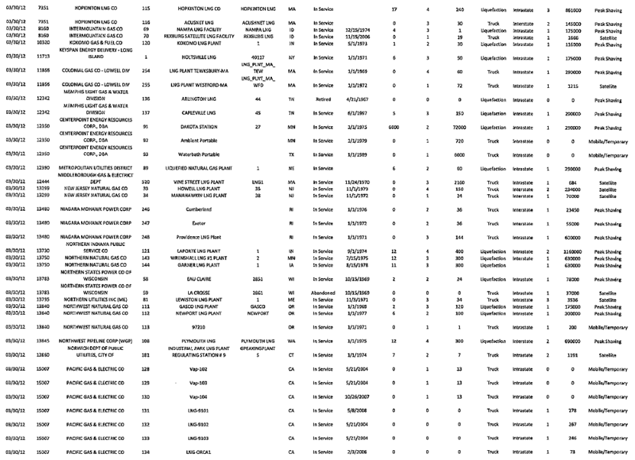
North America’s small scale facilities

Slide 25
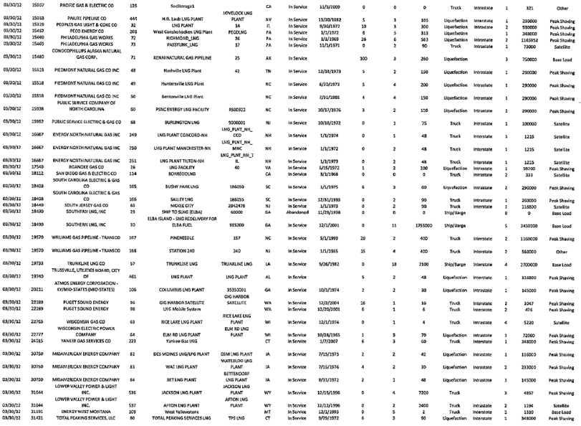
North America’s small scale facilities

Slide 26
North America’s small scale facilities

